Slide 1
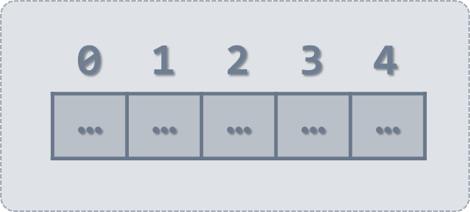
Arrays and Matrices
Arrays, Array Operations, Matrices, Multi-Dimensional Arrays
SoftUni Team
Technical Trainers
Software University
http://softuni.bg

Slide 2
Table of Contents
Arrays is JavaScript
Array Operations
Iteration over Arrays
Push, Pop, Shift, Slice, Join ...
Filter, Map, Reduce ...
Sorting Arrays
Matrices

Slide 3
Have a Question?
sli.do #JSCORE
3

Slide 4
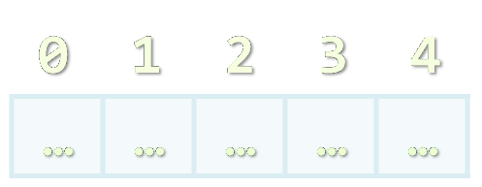
Arrays in JS
Working with Arrays of Elements

Slide 5

What are Arrays?
In JS arrays are ordered sequences of elements
Elements are numbered from 0 to length-1
Arrays hold key-value pairs
Key (0…length-1), value of any type (e.g. number /string /object)
Arrays have variable size – can be resized (unlike C# / Java / C
Element index
Array of 5 elements
… | … | … | … | …
Array element

Slide 6
Arrays – Examples
let arr = [10, 20, 30];
console.log(arr); // [10, 20, 30]
console.log(arr.length); // 3
console.log(arr[0]); // 10
arr[0] = 5; // Elements can be modified
console.log(arr); // [5, 20, 30]
arr.push(500); // Elements are resizable
console.log(arr); // [5, 20, 30, 500]

Slide 7
Problem: Sum First and Last Array Elements
You are given an array of strings holding numbers
Calculate and print the sum of the first and the last elements
20
30
40
60
15
5
10
2
4
function sumFirstAndLast(arr) {
return Number(arr[0]) + Number(arr[arr.length - 1]);
}
sumFirstAndLast(['20', '30', '40']) // 60
Check your solution here: https://judge.softuni.bg/Contests/311

Slide 8
Processing Arrays Elements
let capitals = ['Sofia', 'Washington', 'London', 'Paris'];
for (let capital of capitals)
console.log(capital);
for…of works like foreach
for...in goes through array indices
for (let i in capitals)
console.log(i + " " + capitals[i]);
for (let i = 0; i < capitals.length; i++)
console.log(capitals[i]);
Traditional for-loop

Slide 9
Processing Arrays Elements (2)
let capitals = ['Sofia', 'Washington', 'London', 'Paris'];
capitals.forEach(capital => console.log(capital));
capitals.forEach((capital, i) =>
console.log(i + ' -> ' + capital));
console.log(capitals.join(', '));
console.log(JSON.stringify(capitals));

Slide 10
Problem: Even Position Elements
Find the elements at even positions in array, space separated
20
30
40
function evenPositions(arr) {
let result = [];
for (let i in arr)
if (i % 2 == 0)
result.push(arr[i]);
return result.join(' ');
}
20 40
5
10
5
JS
JS
Check your solution here: https://judge.softuni.bg/Contests/311

Slide 11
Arrays of Different Types
// Array holding numbers
let numbers = [10, 20, 30, 40, 50];
// Array holding strings
let weekDays = ['Monday', 'Tuesday', 'Wednesday',
'Thursday', 'Friday', 'Saturday', 'Sunday'];
// Array holding mixed data
var mixedArr =
[20, new Date(), 'hello', {x:5, y:8}];

Slide 12
JS Arrays and Invalid Positions
let nums = [10, 20, 30];
nums[4] = 50; // Will resize the array
console.log(nums); // [10, 20, 30, ,50]
console.log(nums.length); // 5
console.log(nums[3]); // undefined
console.log(nums[-5]); // undefined
nums[-5] = -5; // Will not resize the array (invalid index)!
console.log([nums[-5], nums.length]); // [-5, 5]
console.log(nums[100]); // undefined
nums[100] = 100; // Will resize the array
console.log([nums[100], nums.length]); // [100, 101]

Slide 13


Array Operations
Push, Pop, Shift, Unshift, Slice, Join, …

Slide 14
Add / Remove Elements at Both Ends
let nums = [10, 20, 30];
console.log(nums.join('|')); // 10|20|30
nums.push(40);
console.log(nums.join('|')); // 10|20|30|40
let tail = nums.pop(); // tail = 40
console.log(nums.join('|')); // 10|20|30
nums.unshift(0);
console.log(nums.join('|')); // 0|10|20|30
let head = nums.shift(); // head = 0
console.log(nums.join('|')); // 10|20|30

Slide 15
Problem: Negative / Positive Numbers
You are given an array of numbers arr
Process them one by one and produce a new array result
Prepend each negative element at the front of result
Append each positive (or 0) element at the end of result
Print the result array, each element at separate line
7
-2
8
9
-2
7
8
9
3
-2
0
-1
-1
-2
3
0
-3
2
-1
0
-1
-3
2
0

Slide 16
Solution: Negative / Positive Numbers
function negativePositiveNumbers(arr) {
let result = [];
for (num of arr)
if (num < 0)
result.unshift(num); // Insert at the start
else
result.push(num); // Append at the end
console.log(result.join('\n'));
}
Check your solution here: https://judge.softuni.bg/Contests/311

Slide 17
Slicing Arrays
let nums = ['one', 'two', 'three', 'four'];
console.log(nums.join('|')); // one|two|three|four
let firstNums = nums.slice(0, 2); // start, end+1
console.log(firstNums.join('|')); // one|two
let lastNums = nums.slice(2, 4); // start, end+1
console.log(lastNums.join('|')); // three|four
let midNums = nums.slice(1, 3); // start, end+1
console.log(midNums.join('|')); // two|three

Slide 18
Splice: Cut and Insert Array Elements
let nums = [5, 10, 15, 20, 25, 30];
console.log(nums.join('|')); // 5|10|15|20|25|30
let mid = nums.splice(2, 3); // start, delete-count
console.log(mid.join('|')); // 15|20|25
console.log(nums.join('|')); // 5|10|30
nums = [5, 10, 15, 20, 25, 30];
nums.splice(3, 2, "twenty", "twenty-five");
console.log(nums.join('|'));
// 5|10|15|twenty|twenty-five|30

Slide 19
Problem: First and Last K Numbers
2
7
8
9
You are given an array of numbers
The first element holds an integer k
Print the first k and the last k from the other elements in the array (space separated)
7 8
8 9
function firstLastKElements(arr) {
let k = arr.shift();
console.log(arr.slice(0, k).join(' '));
console.log(arr.slice(arr.length-k,
arr.length).join(' '));
}
3
6
7
8
9
6 7 8
7 8 9
1
5
5
5
Check your solution here: https://judge.softuni.bg/Contests/311

Slide 20
Problem: Sum Last K Numbers Sequence
Take two integers n and k
Generate and print the following sequence:
The first element is: 1
All other elements = sum of the previous k elements
Example: n = 9, k = 5
120 = 4 + 8 + 16 + 31 + 61
6
3
Sequence:
1 1 2 4 7 13
8
2
Sequence:
1 1 2 3 5 8 13 21
9
5
Sequence:
1 1 2 4 8 16 31 61 120
+
1 1 2 4 8 16 31 61 120
Check your solution here: https://judge.softuni.bg/Contests/311

Slide 21
Solution: Sum Last K Numbers Sequence
function sumLastKNumbersSequence(n, k) {
let seq = [1];
for (let current = 1; current < n; current++) {
let start = Math.max(0, current - k);
let end = current - 1;
let sum = // TODO: sum the values of seq[start … end]
seq[current] = sum;
}
console.log(seq.join(' '));
}
Check your solution here: https://judge.softuni.bg/Contests/311

Slide 22
Filtering and Transforming Elements
let nums = ['one', 'two', 'three', 'four'];
console.log(nums.join('|')); // one|two|three|four
let filteredNums =
nums.filter(x => x.startsWith('t'));
console.log(filteredNums.join('|')); // two|three
let lengths = nums.map(x => x.length);
console.log(lengths.join('|')); // 3|3|5|4
let lengths = nums.map(x => [x.length, x[0]]);
console.log(lengths.join('|')); // 3,o|3,t|5,t|4,f

Slide 23
More Useful Array Methods
let nums = [1, 2, 3, 4];
let numsSum = nums.reduce((a, b) => a + b);
console.log(numsSum); // 10
let reversedNums = nums.reverse();
console.log(reversedNums); // [4, 3, 2, 1]
let allNums = nums.concat(reversedNums);
console.log(allNums); // [1, 2, 3, 4, 4, 3, 2, 1]
let includes = allNums.includes(4);
let index = allNums.indexOf(4);
console.log(includes, index); // true 3

Slide 24
Problem: Process Odd Numbers
You are given an array of numbers
Print the odd numbers, doubled and reversed
10
15
20
25
50 30
function firstLastElements(arr) {
let result = arr
.filter((num, i) => i % 2 == 1)
.map(x => 2*x)
.reverse();
return result.join(' ');
}
3
0
10
4
7
3
6 8 0
Check your solution here: https://judge.softuni.bg/Contests/311

Slide 25
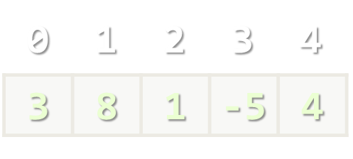
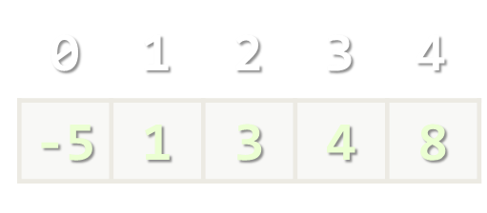
Sorting Arrays
Arranging Elements in Increasing Order

Slide 26
Sorting Arrays
let nums = [20, 40, 10, 30, 100, 5];
console.log(nums.join('|')); // 20|40|10|30|100|5
nums.sort(); // Works incorrectly on arrays of numbers!!!
console.log(nums.join('|')); // 10|100|20|30|40|5
nums.sort((a, b) => a-b); // Compare elements as numbers
console.log(nums.join('|')); // 5|10|20|30|40|100

Slide 27
Problem: Smallest 2 Numbers
You are given an array of numbers
Print the smallest two numbers
30
15
50
5
5 15
function smallestTwoNumbers(arr) {
arr.sort((a, b) => a-b);
let result = arr.slice(0, 2);
return result.join(' ');
}
3
0
10
4
7
3
0 3
Check your solution here: https://judge.softuni.bg/Contests/311

Slide 28
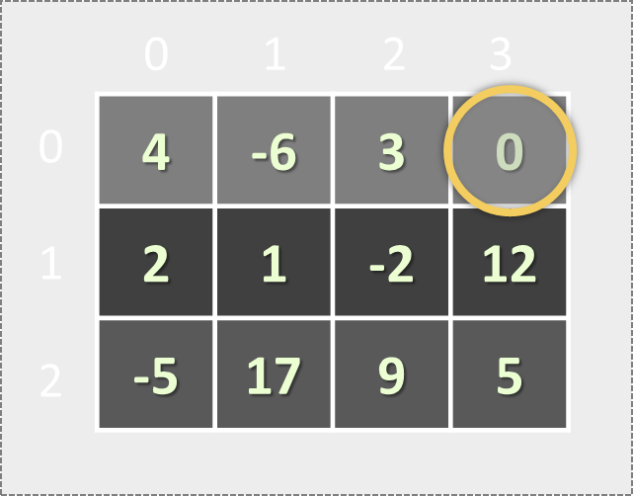
Matrices (Tables)
Arrays Holding Arrays

Slide 29
Matrices in JS
A matrix is a table of values
Represented as nested arrays in JavaScript
0 1 2 3
4 | -6 | 3 | 0
Matrix of 4 rows
0
1
2
3
2 | 1 | -2
let matrix = [
[4, -6, 3, 0],
[2, 1, -2],
[-5, 17],
[7, 3, -9, 12]
];
-5 | 17
Element matrix[2][0] at row 2, column 0
7 | 3 | -9 | 12

Slide 30
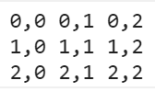
Matrix – Example
Defining a matrix (array of arrays)
Printing a matrix
let matrix = [
['0,0', '0,1', '0,2'],
['1,0', '1,1', '1,2'],
['2,0', '2,1', '2,2']
];
Join the cells in each row by ' ', then join the rows by '\n')
console.log(
matrix.map(row => row.join(' '))
.join('\n'));

Slide 31
Problem: Biggest Element in Matrix
You receive a 2D matrix of numbers as an array
Each element of the input array is an array of numbers
Write a JS function to find the biggest number
3 5 17 12 91 5
-1 7 4 33 6 22
1 8 99 3 10 43
3 5 7 12
-1 4 33 2
8 3 0 4
20 50 10
8 33 145
99
33
145

Slide 32
Solution: Biggest Element in Matrix
function biggestElement(matrix) {
let biggestNum = Number.NEGATIVE_INFINITY;
matrix.forEach(
r => r.forEach(
c => biggestNum = Math.max(biggestNum, c)));
return biggestNum;
}
20 50 10
8 33 145
biggestElement([[20, 50, 10], [8, 33, 145]]); // 145
Check your solution here: https://judge.softuni.bg/Contests/311

Slide 33
Problem: Diagonal Sums
You receive a 2D matrix of numbers as an array
Each element of the input array is an array of numbers
Find sum at the main and at the secondary diagonals
20 40
10 60
3 5 17
-1 7 14
1 -8 89
80 50
99 25

Slide 34
Solution: Diagonal Sums
function diagonalSums(matrix) {
let mainSum = 0, secondarySum = 0;
for (let row = 0; row < matrix.length; row++) {
mainSum += matrix[row][row];
secondarySum += matrix[row][matrix.length-row-1];
}
console.log(mainSum + ' ' + secondarySum);
}
3 5 17
-1 7 14
1 -8 89
diagonalSums([[20, 40], [10, 60]]); // 80 50
Check your solution here: https://judge.softuni.bg/Contests/311

Slide 35
Problem: Equal Neighbors
You are given a matrix of elements
Find the number of equal neighbors
2 3 4 7 0
4 0 5 3 4
2 3 5 4 2
9 8 7 5 4
2 2 5 7 4
4 0 5 3 4
2 5 5 4 2
test yes yo ho
well done yo 6
not done yet 5
5
2
1

Slide 36
Problem: Equal Neighbors
function equalNeighborsCount(matrix) {
let neighbors = 0;
for (let row = 0; row < matrix.length-1; row++)
for (let col = 0; col < matrix[row].length; col++)
if (matrix[row][col] === matrix[row + 1][col])
neighbors++;
// TODO: check also the horizontal neighbors
return neighbors;
}
2 2 5 7 4
4 0 5 3 4
2 5 5 4 2
Check your solution here: https://judge.softuni.bg/Contests/311

Slide 37


Live Exercises

Slide 38

Summary
Arrow functions ≈ short function syntax
Arrays in JS hold sequence of elements
Elements are accessed by index
Behave like lists (add / delete elements)
Matrices are arrays holding arrays
let nums = [10, 20, 30, 40];
nums[2] = 100;
nums.push('new element');
let matrix = [[10, 20], [30, 40]];
27

Slide 39
https://softuni.bg/trainings/2080/js-fundamentals-september-2018
Notes:
© Software University Foundation – http://softuni.org
This work is licensed under the Creative Commons Attribution-NonCommercial-ShareAlike license.
43

Slide 40













SoftUni Diamond Partners

Slide 41





SoftUni Organizational Partners

Slide 42




Trainings @ Software University (SoftUni)
Software University – High-Quality Education and Employment Opportunities
softuni.bg
Software University Foundation
http://softuni.foundation/
Software University @ Facebook
facebook.com/SoftwareUniversity
Software University Forums
forum.softuni.bg
Notes:
© Software University Foundation – http://softuni.org
This work is licensed under the Creative Commons Attribution-NonCommercial-ShareAlike license.
43

Slide 43

License
This course (slides, examples, demos, videos, homework, etc.) is licensed under the "Creative Commons Attribution-NonCommercial-ShareAlike 4.0 International" license
43
Notes:
© Software University Foundation – http://softuni.org
This work is licensed under the Creative Commons Attribution-NonCommercial-ShareAlike license.
<number>

